Slide 1
The story behind (and after) the Wow Factor
Professor Dr Anne Bamford

Slide 2
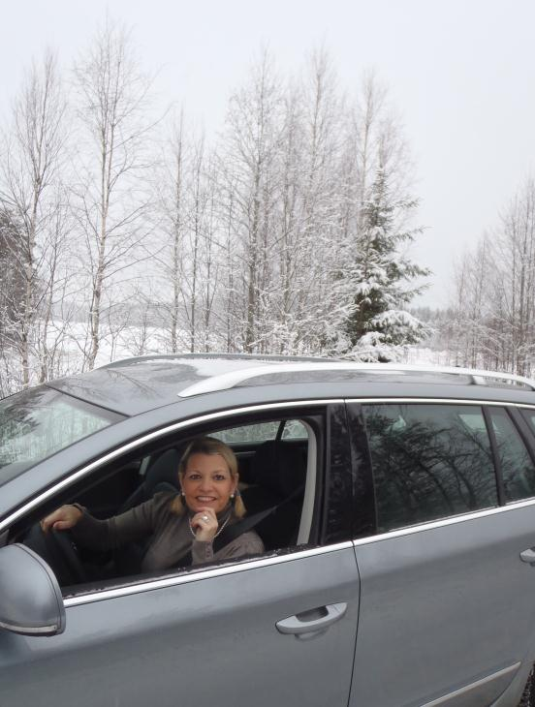

Slide 3
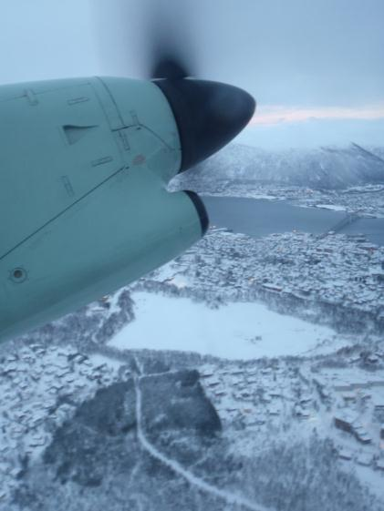

Slide 4
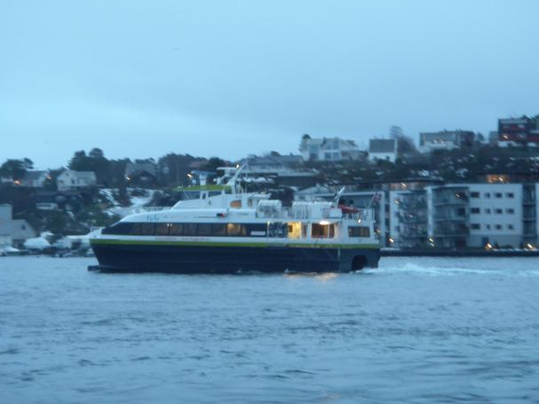

Slide 5
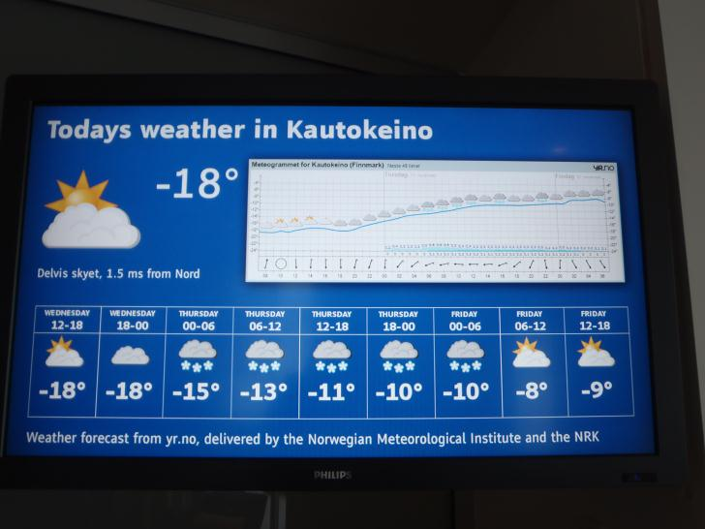

Slide 6
Studies conducted to date
Denmark
Iceland
(also study in Finland)
Belgium
The Netherlands
Hong Kong
Australia (EAPI)
United Kingdom (WO Music, prisons, early years, artists, and FYT)
Disability arts
Visual literacy
3D in education

Slide 7
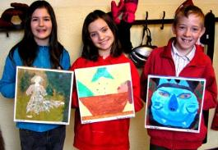
Denmark http://www.kunststyrelsen.dk/db/files/ildsjaele_in_the_classroom.pdf
Research
The establishment of a centre of knowledge for the arts and cultural subjects
Assessment
The evaluation process continues to need strengthening, and the educational results need to be made apparent throughout the entire programme of education
Sustained
The number of teaching hours needs to be increased
Professional development
Continuing education and teacher training opportunities for artists and teachers
Partnership
The establishment of a Cultural Ambassador arrangement
Involving artists in school teaching
More offers of artistic experiences
Notes:
Advisory Panel on Strengthening the Practical/Art Subjects in Municipal Primary and Lower Secondary Schools
Forward
On behalf of the Danish Arts Council, Anne Bamford, professor at Wimbledon College of Arts, prepared a report, “The Ildsjæl (Fiery Soul) in the Classroom”, on the practical/art subjects in the Danish Folkeskole (municipal primary and lower secondary schools). The report included a number of recommendations, which were then discussed between the Danish Arts Council and the Ministry for Education, and it was agreed that focus should be placed on a special, inter-ministerial cooperative effort with the aim of strengthening the practical/art subjects in the Folkeskole.
The Department for Primary, Lower Secondary and General Adult Education therefore established an advisory panel that was to come up with recommendations/initiatives for how education in the practical/art subjects in the Folkeskole – home economics, textile design, wood/metalwork, music and art – could be strengthened.
The advisory panel’s task was to analyse and evaluate the content of these subjects and their interaction with each other, as well as their relevance to the Folkeskole of today, including their designations and scope. It was also the function of the advisory panel to evaluate the conditions of the practical/art subjects, including the extent to which they are taught by teachers who are specially trained to teach in these subjects, continuing education and training for the teachers, research and the academic level of the courses.
In the Government’s Strategy for Denmark in the Global Economy, “Progress, Innovation and Security”, from 2006, in the section on the Folkeskole it is emphasised that, as an extension of the new object clause, an assessment of all of the subjects’ aims will take place and that preliminary and end targets will be adjusted accordingly. Thus, the intention was that the advisory panel would be able to provide recommendations based on the members’ expertise that would be able to contribute to this work.
The advisory panel consisted of one member from each of the academic organisations for: home economics, textile design, wood/metalwork, music and art; five members appointed by the Minister for Culture; as well as one member appointed by the Minister for Education.
The Department for Primary, Lower Secondary and General Adult Education was responsible for the chairmanship and the secretariat function in collaboration with the Ministry of Culture.
Seven meetings were held. Professor Anne Bamford participated in the first and the last of these meetings.
The Advisory Panel members:
Ulla Hedegaard, President of the Association of Teachers of Home Economics
Karen Sandager, President of the Danish Association of Teachers of Textile Design
Leif Rosenbech, President of the Danish Association of Teachers of Wood and Metalwork
Bente Søndergaard, President of the Association of Teachers of Music in the Folkeskole
Alice Carlslund, President of the Danish Association Teachers of Art
Michael Bojesen, Choral Director of the Danish National Broadcasters’ Girls’ Choir
Frans Jacobi, Sculptor and member of the Danish National Arts Council
Lars Brinck, Associate Professor at the Danish Rhythmic Music Conservatory and the Music Educators’ Skill Centre
Karen Harsbo, Head of the Royal Danish Academy of Fine Arts, Schools of Visual Art’s Laboratory for Ceramics
Søren Bøjer Nielsen, Music Director of the Copenhagen Philharmonic Orchestra, Chairman of the Danish National Arts Council’s Committee on the Practical/Art Subjects
Jan Helmer-Petersen, Senior Consultant for the Network for Children and Culture
The advisory panel’s introduction
The advisory panel supports the Minister for Education and the Minister for Culture’s desire to strengthen the practical/art subjects in the Folkeskole.
The “practical/art subjects” is a shared designation for a number of widely diverse subjects. The subject’s present breadth in the Folkeskole’s curriculum is the result of an historical development. Common to all of the subjects is the fact that they provide the necessary foundation for the development and formation of a well-rounded personality, where the individual student is given an opportunity to develop their potential to its fullest.
Experience with and recognition of your self in the world around you occurs in a variety of ways and involves all of the senses. The forms of expression of the various senses are represented by the artistic, cultural and handicraft based subjects. These subjects therefore play an important role in a school system that is dedicated to a humanistic and democratic tradition.
These subjects allow for a special opportunity to engage in creative activities of an artistic, aesthetic nature; to explore in depth and with enthusiasm issues that lie ”deep beneath the skin” of children and young people because reflective thinking and emotional engagement are interactively involved.
The advisory panel finds it important that the artistic subjects be given an importance in and of themselves. The creative dimension in the Folkeskole needs to be strengthened because it increases the collective foundation of knowledge and because it makes the life of the individual richer and more multi-faceted.
The practical/art subjects have though also an importance that reaches beyond this.
An education in the schools that emphasises academic achievement in the humanities, mathematics, science and the practical/art subjects is a necessity if Denmark is to be among the most innovative countries in the world.
Teachers in the schools need to be aware of the methods and forms of teamwork that encourage imagination and innovative cooperation. In the long run, pedagogical methods and techniques that can stimulate and develop the students’ creative competencies will assist in creating a strong culture of independence and solidarity in Danish society. Thus, education in these subjects places special demands on the teacher in order to be able to command the artistic approaches and handicraft based skills that are required in this field of work.
Through an education in the practical/art subjects, students learn to make use of working methods and techniques of a practical, musical, creative and artistic nature. Strengthening the practical/art subjects so that the students attain greater knowledge and acquire better skills will increase their understanding of the connection between theoretical knowledge and practical possibilities. This understanding and competence will prepare the students to possess initiative and see new and perhaps different possibilities when problems need to be solved – not just in assignments in connection with school subjects or cross-curricular projects, but also in their future activities at work and in their free time.
The advisory panel has been free to propose suggestions without having to take into consideration the specific economic priorities that will be necessary in the implementation phase.
Dance, drama and film and media studies were not included in the advisory panel’s scope of discussion. These subjects also play a primary roll in the students’ well-rounded development and should therefore be taken into account in and across schools’ curricula.
The advisory panel’s recommendations
Below are listed the panel’s recommendations, which involve the subjects’ designations and scope, but also include evaluations and exams, teacher qualifications, cooperation between cultural institutions and schools, as well as research and knowledge sharing.
1. The subjects’ designations and scope
Common for all the courses in the practical/art subjects is that not just that the number of teaching hours needs to be increased but also that the content, placement and progression of these subjects within the programme of education as a whole needs to be strengthened
The courses for all the specified form levels need to be made compulsory and take place regularly throughout the entire school year, and a minimum number of yearly lessons should be specified for each individual subject. The advisory panel finds it problematic that there is a tendency for the teaching in certain practical/art subjects at some form levels to be organised only into short, concentrated periods, with a relatively large number of hours allocated. Intensive projects can supplement and provide perspective to the regular programme of teaching, but they cannot replace the benefit that the students gain from regularly recurring training and skill development within the subjects’ individual disciplines.
A regular programme of education in music throughout the school year be made compulsory for the 1st through the 9th form levels
Song and music are a fundamental form of human expression. In the subject of music, the knowledge needs to be made systematic and the skills need to be practiced, and the students should experiment and gain experience from the sonorous world around them. Besides the purely academic content, music provides a tool for developing an individual’s identity and need to express themselves, which aids in strengthening children and young people’s sense of community and self-image. Significant experiences, familiarity with and knowledge about music can only be achieved through music itself. Working with music requires a special level of necessary prerequisites, whether it involves practical music exercises or working with music in the form of actively listening to music.
Music is such a significant factor in our society and in children and young people’s personal, social and cultural development that regular education in the subject ought to be extended to include the entire compulsory programme of education. In one form or another, music plays an important role for all young people. This, in itself, could provide such potential that the schools ought to make it a part of the entire school programme.
Community singing receives a central role in the schools’ daily routine
Singing together strengthens immensely a sense of community across form levels, culture and age differences. As a way of being together, community singing provides a unique opportunity for the schools’ students to both hear and feel what it means to be part of a shared community with a common culture, where the lyrics and melody of the song provide a shared context.
A regular programme of education in the visual arts throughout the school year be made compulsory from the 1st through the 9th form levels
It is especially problematic in the context of the school system that art is primarily defined as a subject for younger children. The themes that the visual arts have explored throughout time are universal and not just the domain of students aged from 7 to 11. By concluding education in art after the 5th form level, the students’ development in drawing is stunted, and the majority of them leave the Folkeskole with a lack of skills in the visual arts. Just at the point when the students are beginning to face the challenges to identity involved with puberty, and when their worldview is changing, they are given no guidance in how to “see”, understand, describe and express the world around them in visual terms.
Working to create visual images with topics and themes can give a new understanding of your self and of the world around you. Especially among the schools’ older students, the visual image, including the digital media, has a power to fascinate that makes it necessary for the visual arts subjects also to work with the means used in such visual narratives as TV, computer games and the internet.
The visual arts supplements and replaces parts of the visual content from the subject of Danish in advanced level programmes
By working with the visual arts, multimedia production and other visual communication fields, the subject of visual arts supplements and replaces the parts of Danish teaching concerned with the visual image. This means that the students are given the opportunity to have direct experience with visual images through both theoretical and practical image production work.
It is important for the students to get experience with as many visual forms as possible, seeing as we live in a culture of manifold visual images, where they must, on a daily basis, decode more and more information from images on a plane, in three dimensions as well as digital images. The visual arts will be able to increase the students’ possibilities for acquiring forms of expression and presentation that they will be able to use in, among other things, the formulation and presentation of the project assignment in the 9th form level. Additionally, the students will come to acquire the fundamental visual competencies that they can make use of in their future lives as citizens in society.
The artistic dimension is to be highly prioritised in music and the visual arts
Music and the visual arts are art-based subjects. It is not least the artistic dimension that distinguishes these subjects from the other subjects in the Folkeskole and which accounts for their special justification in the schools’ curricula. With artistically competent teachers as roll models, the students have the opportunity to experience what artistic ability means and what opportunities arise from acquiring and mastering specific artistic skills and forms of expression.
As a replacement for the subjects wood/metalwork and textile design, a new subject called handicraft and design is to be established in the Folkeskole. A regular programme of education in the subject throughout the school year be made compulsory from the 4th through the 9th form levels
Danish handicraft and design are known throughout the world, and a new subject in school would be able to promote both the students and their parents’ understanding of the importance of focusing on this aspect. A consolidation of these subjects would provide the students with a broader spectrum of materials and working methods. It would strengthen their opportunity for working with a variety of different forms of design processes. Both wood/metalwork and textile design are founded on the theory and practice of handicraft and design, which naturally leads to the thought of combining aesthetic expression and practical function in the finished product. Both subjects are involved with working with materials and solving problems. Similarly, they both involve complimentary cultural historical and socially related fields of study. These issues are to be retained as a dimension in the subject of handicraft and design.
In the subject handicraft and design, the students will learn craftwork skills in combination with experimental working processes with the intention of developing problem solving competencies. Handicraft and design would be able to increase the opportunities for the student to acquire the forms of expression and performance that they will be able to use in relation to, among other things, the project assignment in the 9th form level.
Combining wood/metalwork and textile design should be a process that takes place over a period of time so that there is an opportunity for the new subject to develop a clearly defined and forward-thinking identity
It is necessary that the new subject be developed over a period of time in order to allow for the opportunity to provide additional training for the teachers, launch development initiatives – possibly in the form of cooperation between the Folkeskole and teacher training – as well as training teachers to be specialised in the new main subject, material design.
A regular programme of education in home economics throughout the school year be made compulsory from the 4th through the 7th form levels.
By virtue of its mission and its central areas of knowledge and skills, home economics has the specific qualities necessary for contributing to teaching in the health-related topics so that the students receive the best foundation for a good and healthy life.
In order to strengthen the teaching in the health-related topics, a cross-cutting cooperative effort between the subjects of home economics and physical education that extends beyond the compulsory education in home economics is recommended
Home economics and physical education are both subjects that place focus on the body, health and quality of life. Cooperation between these subjects would strengthen the students’ understanding of the connection between nutrition, exercise and physical activity.
2. Evaluations and exams
The evaluation process continues to need strengthening, and the educational results need to be made apparent throughout the entire programme of education
Evaluations could take the form of comments on the students’ exhibitions, concerts or fashion shows. The work on the exhibitions and concerts ought to place special focus on strengthening the artistic contents of the subjects and help to motivate the students.
Music, visual arts, handicrafts and design together with home economics are to have the status of exam subjects
Leaving exams would provide an increased focus on and importance to the contents of the subjects as well as strengthening their place within the programme of education. The Danish Evaluation Institute’s (EVA) report from November 2002 provides documentation for the great importance attached to the status of a subject if it includes the possibility of a leaving an exam. Moreover, it also affects the discipline and motivation of both students and teachers in terms of the day-to-day teaching.
The students should have the same opportunity to document their knowledge and skills in these subjects as they do in the other compulsory subjects in the Folkeskole. This would mean that more schools than at present would allow teachers that are specially trained in teaching these subjects, or people with equivalent qualifications, to teach music, visual arts and handicrafts and design.
3. Teacher Qualifications
Cooperation between teachers’ colleges and the artistic education programmes needs to be increased
Increased cooperation would strengthen the artistic dimension and the academic quality in teacher training and thereby also in the Folkeskole. In practice, this cooperation could for example concern teacher resources and facilities.
To a greater degree the schools need to make use of the opportunity to hire people with special qualifications in music and the visual arts, for example people who have graduated from academies of music or fine arts
The students in the Folkeskole need to be taught by teachers who have the necessary academic background. In the practical/art subjects it is better that the students are taught by people with specific qualifications than by teachers who have not specialised in these areas, or by teachers without the necessary academic background for teaching these subjects. The opportunity for hiring people with specific qualifications is already provided for in section 28, article 2 of the Folkeskole Act, but the impression of the panel is that this opportunity is very rarely taken advantage of. In practice, such employment could take place for example by schools taking greater advantage of the possibility for employing teachers in combination positions, for example in cooperation with music schools.
More funds are to be allocated by the schools for the continuing education and training of teachers in the practical/art subjects
It is the impression of the panel that schools allocate only a very limited amount of funds for the continuing education and training of teachers in the practical/art subjects. Strengthening these subjects requires that an appropriate amount of funds be allocated to the continuing education and training of teachers so that the teachers can keep abreast with the developments within their respective subjects.
Continuing education and training of Folkeskole teachers in coordination with the Ministry of Culture’s institutions
The Ministry of Culture’s Institutions – academies of art and music, etc. – can provide or contribute to the continuing education and training of teachers in the practical/art subjects in the Folkeskole.
Master’s degree programmes in which the theoretical and practical disciplines are given equal weight are to be established for all of the practical/art subjects
Master’s degree programmes would help to strengthen the academic level in the Folkeskole and make it more attractive for teachers to continue their education. There is an impression among the panel that the continuing education within these subjects is lacking a practical, methodological aspect. The opportunity for teachers to continue their education, which was previously offered by the Danish University of Education by way of yearlong courses and a Master of Education programme, has not been satisfactorily replaced by currently existing opportunities for continuing education and training.
It needs to be made clear that the meritlæreruddannelse (an accelerated primary and lower secondary teacher programme with an award of credit for prior learning) is available for people with Bachelor degrees in artistic subjects
By ensuring better awareness of the fact that people with Bachelor degrees in artistic disciplines have access to the meritlæreruddannelse, another opportunity for strengthening the Folkeskole’s academic environment will be created.
An admission examination should be implemented for those wishing to choose music as their main subject at teachers’ colleges
Besides the current requirement of a B-level from an upper secondary school, an admission examination where the student would need to demonstrate sufficient musical skills is to be implemented.
The current subject in design in the upper secondary schools needs to be modified so that it is adapted to include also handicraft based training competencies within a broad spectrum of materials and techniques
In order to be admitted to a main subject programme at a teachers’ college, it should be required that the applicant have competencies equalling a B-level from an upper secondary school. This would require that the upper secondary schools be able to meet the requirements in these subjects that it would be reasonable to demand from future graduates.
4. Cooperation between the institutions of culture and schools
Increased cooperation between schools and cinemas, theatres, dance performances and regional orchestras
The existing system of subsidies for music, theatre and dance are often based on offers for these institutions to visit the schools. Other systems, such as ”With the School in the Cinema” and similar offers from regional orchestras and theatres invite the schools inside these cultural institutions. This type of cooperation between schools and cultural institutions should be promoted and developed so that it can come to include schools throughout the whole country.
Increased cooperation between schools and museums, libraries and archives
Many schools already have a close working relation with local museums, and many museums have established special school centres to facilitate this type of cooperation. This kind of contact could also be expanded to include libraries and provincial historical archives so that an understanding of cultural heritage could be extended to areas other than museums.
Increased cooperation between schools and cultural schools, i.e. music schools, art schools, drama schools and media schools
There is already a place for a comprehensive cooperation between schools and music schools, which benefits both parties. This kind of cooperation could also be expanded to include other types of cultural schools and further developed to be able to take place as a part of regular school teaching but also as a free time activity.
Increased cooperation between schools, cultural associations and organisations
Many cultural associations and organisations would like to work together with schools, either at the schools or in centres in the local area. Physical education has lead the way in demonstrating how such cooperation can work, both in terms of facilities and instructors, and this would be able to be expanded to include other fields of culture and art.
More offers of artistic experiences similar to the present children’s theatre reimbursement scheme, school concerts, and cinema programmes
The existing arrangements with offers concerning theatre and dance performances, concerts and cinema visits respectively have shown that there is a great interest among schools to give students the opportunity to experience art on a professional level. These opportunities are unevenly distributed geographically, and therefore expanding the arrangements to cover more areas of the country should be considered.
Involving artists in school teaching
The present reimbursement schemes such as the Huskunstnerordning (resident artist scheme), where the students meet practicing professional artists, only include artists from the fields of music, theatre, the visual arts and literature. This scheme would be able to be expanded to include professionals from the fields of film, media, design, architecture and the circus entertainment.
More information for schools concerning the offers provided by cultural institutions
The amount of information concerning offers to schools from cultural institutions could be increased for example through the existing web portals, such as EMU (the Danish education portal), Børnekulturportalen (the children and culture portal), as well as others. The cooperation between the Ministry of Education and the Ministry of Culture (Network for Children and Culture) in order to raise the awareness of the existing offers and activities at the cultural institutions could also be strengthened.
The establishment of a Cultural Ambassador arrangement
Experience from a number of municipalities has shown that a contact teacher arrangement in the cultural field at the municipalities’ schools often leads to increased cooperation and more activities. Such an arrangement, which is known, from among other places such as Nordjylland (North Jutland), would be able to be established on a nation-wide basis with the existing educational institutions and the individual municipalities as coordinators.
Continuing education and training opportunities for artists, etc.
The Huskunstnerordning and similar schemes in the field of music have pointed to the need for offers of short-term courses for artists and art educators who are to work in schools or leisure-time institutions. The centres for higher education as well as the education institutions under the Ministry of Culture would be able to be involved in this effort.
5. Research and knowledge sharing
Increased research in the schools’ practical/art subjects
Throughout the years, research in the practical/art subjects in schools has been of a sporadic nature in terms of content as well as scope. Over a number of years, a special effort of research in this area would be able to strengthen education in the practical/art subjects. The Ministry of Culture’s art schools would be able to contribute with expertise in this area. Moreover, the visual-pedagogical research, which previously has taken place at the Danish University of Education, is to be resumed. This research had very close ties to the school’s education in the visual arts and was a positive driving force in the development of visual arts as a field of study.
The establishment of a centre of knowledge for the arts and cultural subjects
In line with a number of other centres of knowledge in dealing with schools, establishing a centre of knowledge for art and culture, communication, education and aesthetics could be considered. The centre would also be able to provide practical solutions to some of the tasks that are involved in the suggestions above.

Slide 8

Flanders http://www.nsds.be/web/canon/admin/media/14585_41.pdf
Teacher education and professional development
Accessibility in school and out of school
Policy level disagreements
Continuity of experiences
Vocational education
Multiple systems
Mobilising the professional groups

Slide 9
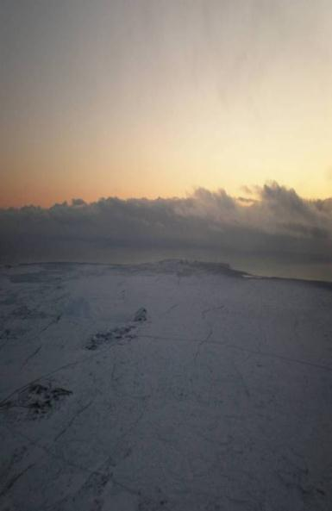
Iceland
Policy and implementation
Collaboration and sharing
Accessibility
Assessment and evaluation
Teacher education

Slide 10
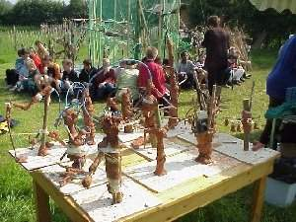
The Netherlands http://www.minocw.nl/english/culture/index.html
Long term partnerships
Joining the dots
Cultural agencies
Continuous learning lines
Teachers
Monitoring
Funding

Slide 11
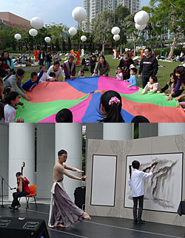
Hong Kong
Schools - partnerships
Tertiary education – interdisciplinary
Non-formal arts education
Audience development
Environment for the arts
Policy, institutions, resources

Slide 12
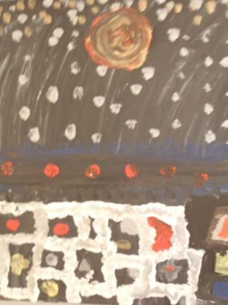
Norway strengths include…
Cultural Rucksack
Community resources
Passion and commitment
Intrinsic value
Amateur arts
Associations
Facilities in the community

Slide 13
Emerging themes include…
Connections between in school and out of school provisions
Teacher education and professional development
Spaces, places and time for arts and cultural education
Curriculum pressures and perceptions reduce the emphasis given to creative and cultural learning
Vocational and career advice for the creative industries
Equality
‘Mixed messages’ prevent quality arts and cultural education
Need for greater levels of integration of ICT in creative and cultural areas

Slide 14
Ongoing issues
Access and equity
Teacher Education
Continuity
Policy connections
Time, space and place in the curriculum
Pisa
Industry
Foundations
Funding

Slide 15

The How Factor
Strategy – clear, sustainable and shared
A seat at the table – impact and influence
Relevance and focus – regular monitoring and QA
Understanding the needs – all stakeholders
Execution matters - delivery improves credibility and earns the right to shape the future
Shared Stories –engagement and joint ownership
Concentrating on capability – do what we do well

